Slide 1
Wireless LANs

Slide 2
Wireless LANs
Additional complications
Different node coverage regions
Hidden Terminals / Exposed Terminals
Impossible to detect collisions

Slide 3
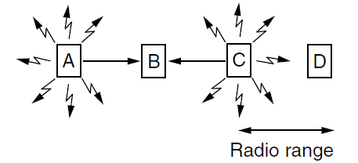
Hidden Terminals
Hidden terminals: Nodes that cannot hear each-other (A and C) but that nevertheless collide at intended receiver (B).

Slide 4
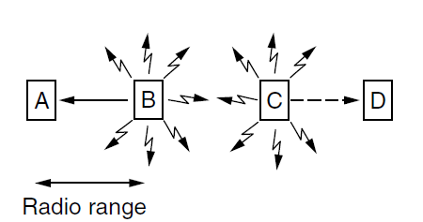
Exposed Terminals
Exposed Terminals: Senders that can hear each other (B and C) but that can transmit to different receivers (A & D) without colliding.

Slide 5
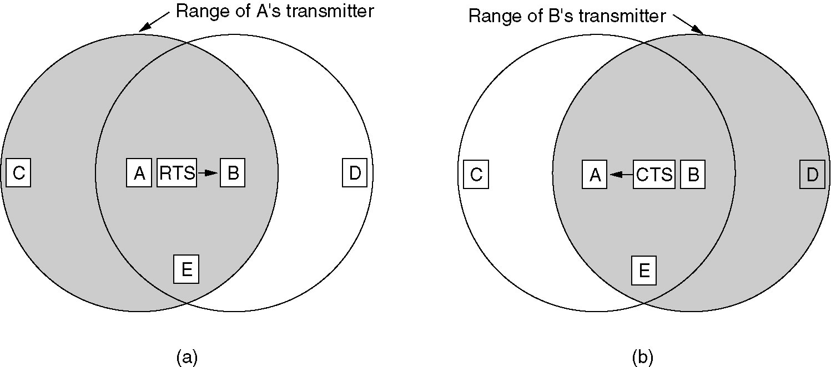
Multiple Access with Collision Avoidance (MACA)
(a) A sending an RTS to B.
(b) B responding with a CTS to A.

